Slide 1
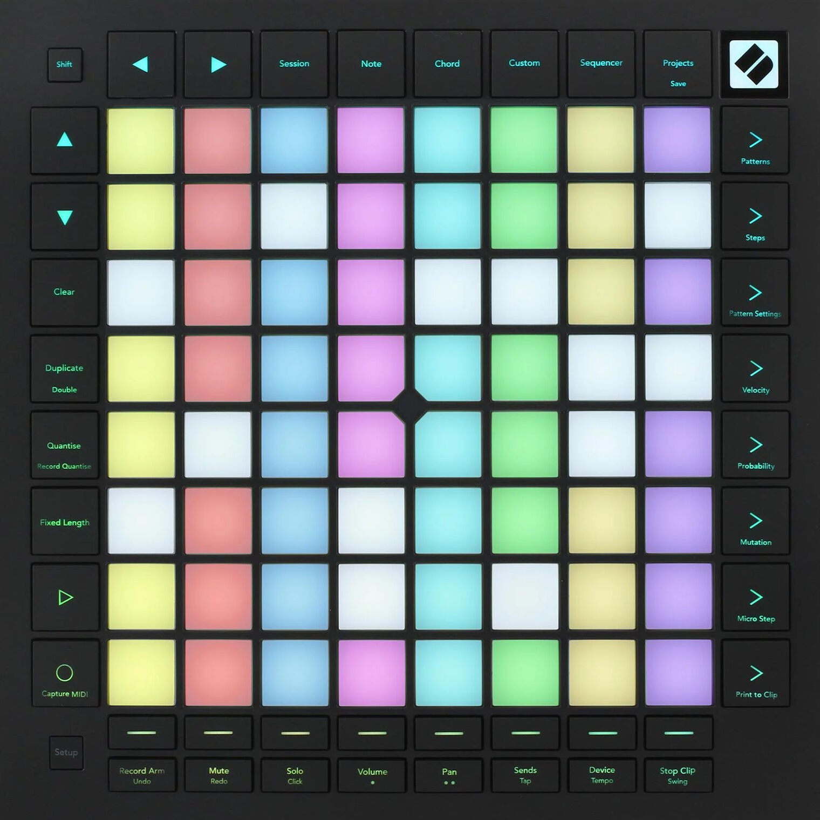
Ninja Pulse
Your objective is to remember a sequence of shurikens, and input it on the Ninja Pulse in the same order.

Slide 2

Ninja Pulse

Slide 3
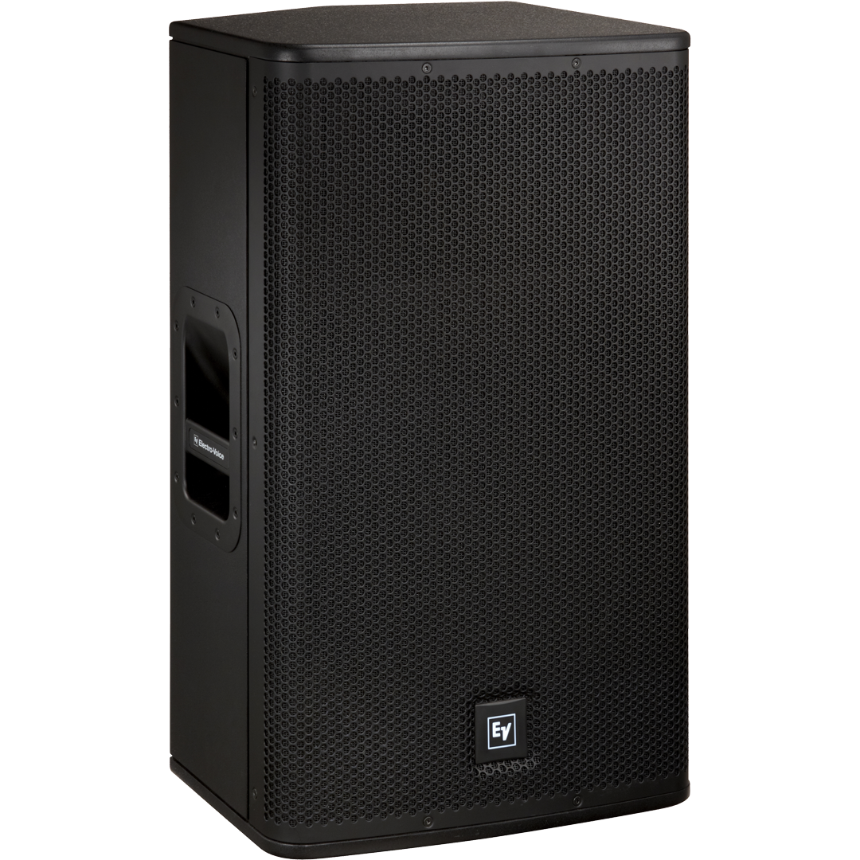


Ninja Pulse
Shuriken
Left
Right

Slide 4
Listen on both sides
Your objective is to remember a sequence of shurikens, and input it on the Ninja Pulse in the same order.
Left
Right

Slide 5
After the sound ends…
Listen on both sides
Your objective is to remember a sequence of shurikens, and input it on the Ninja Pulse in the same order.
2) 3x
1) 2x
Left
Right

Slide 6
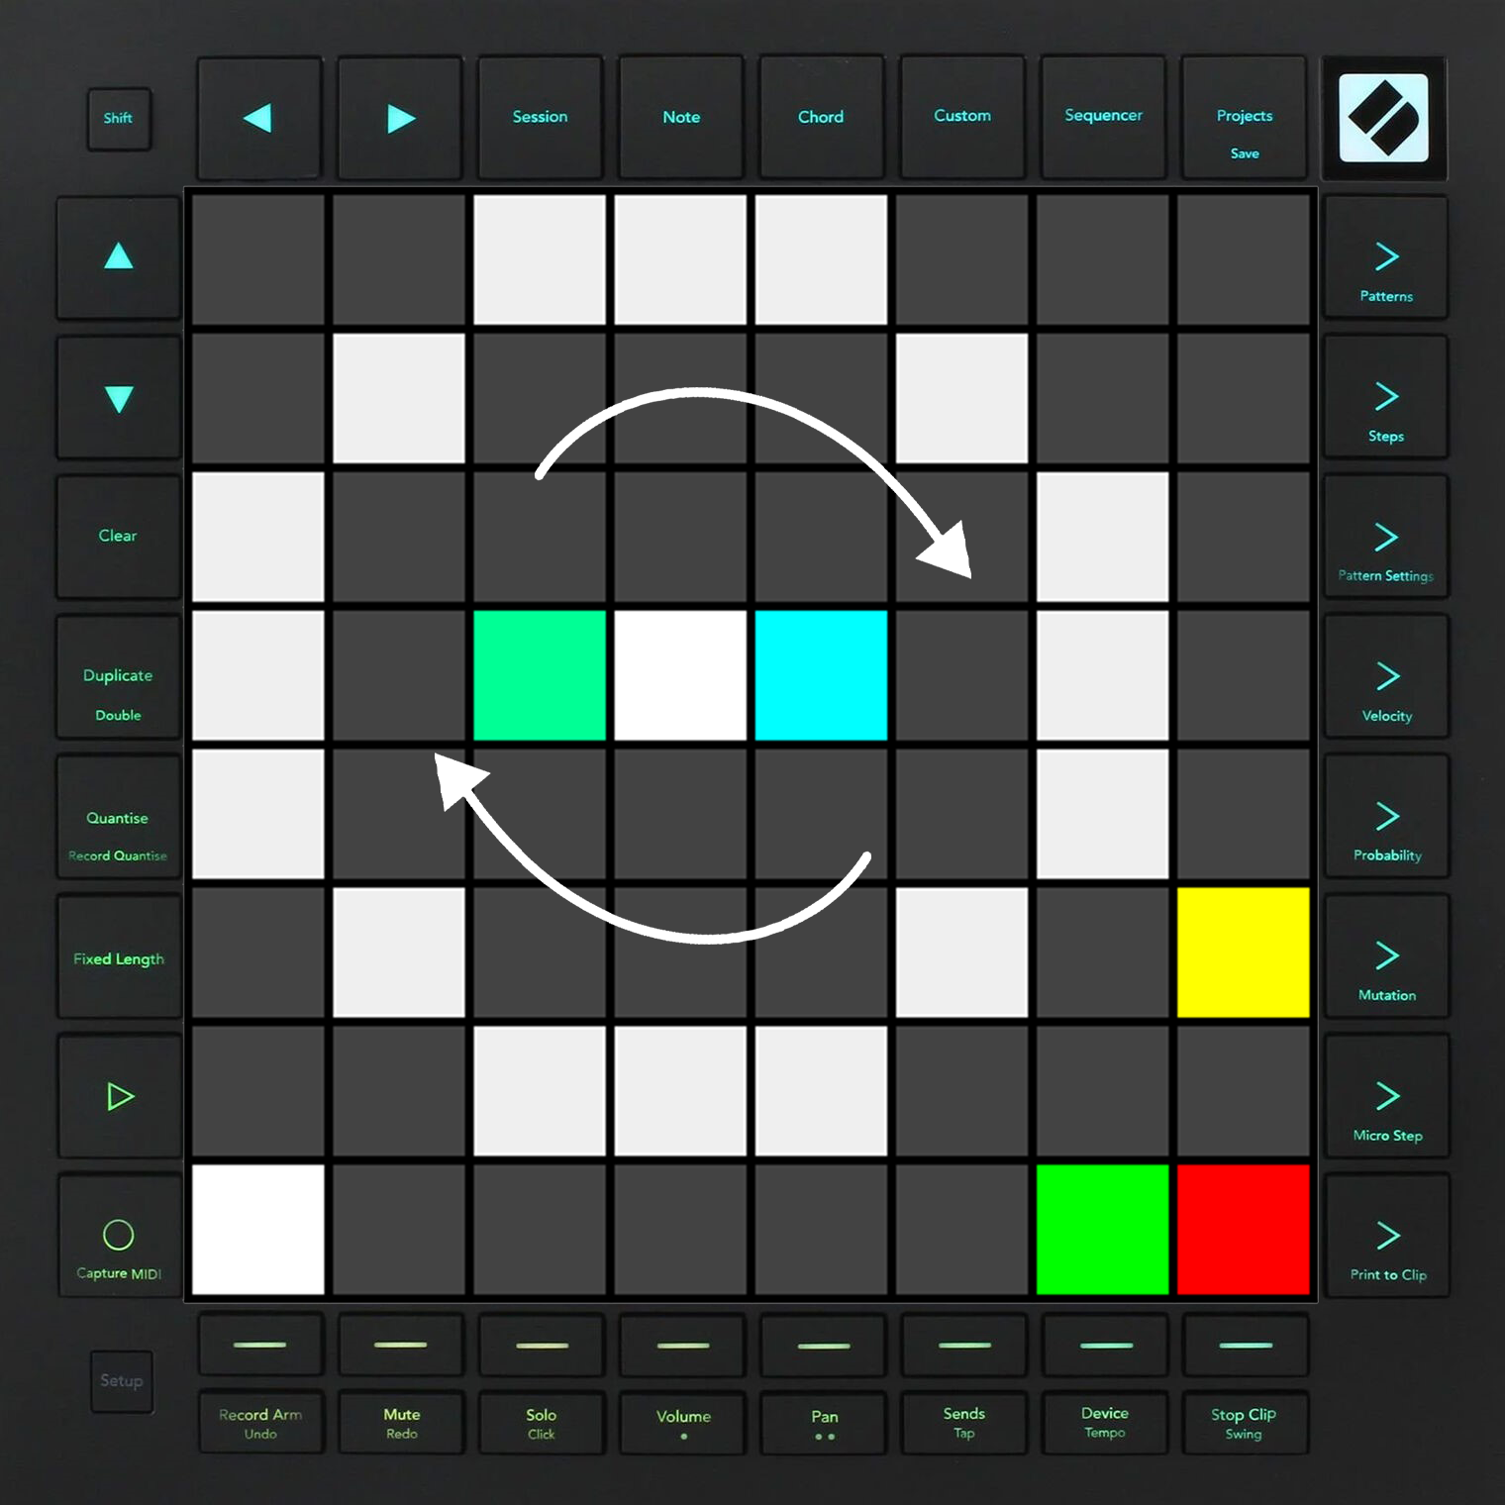

After the sound ends…
Your objective is to remember a sequence of shurikens, and input it on the Ninja Pulse in the same order.
2) 3x
1) 2x
Left
Right

Slide 7
Press 2 times
2) 3x
1) 2x

Slide 8
Easy Mode
Press 3 times
2) 3x
1) 2x

Slide 9
Your objective is to remember a sequence of shurikens, and input it on the Ninja Pulse in the same order.
Press 3 times
Easy Mode

Slide 10
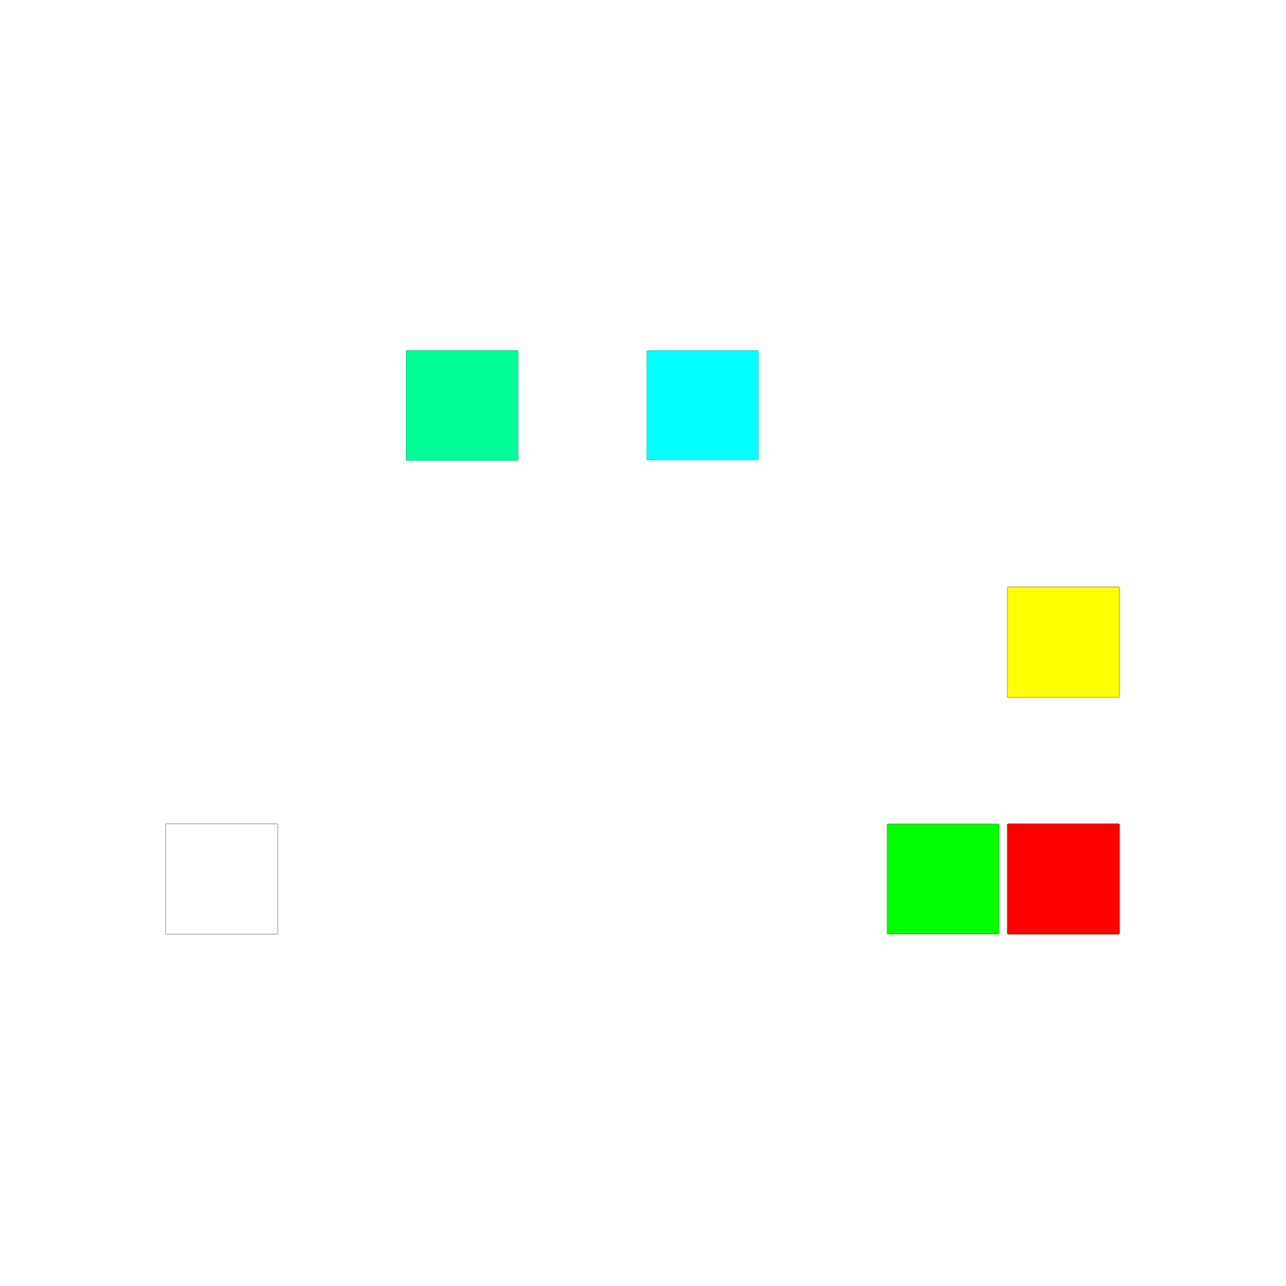
Easy Mode
Right Button
Left Button
Submit Button
Easy Mode
Level starts
Hard Mode

Slide 11

If you fail to input correctly, you will be punished via smoking.

Slide 12
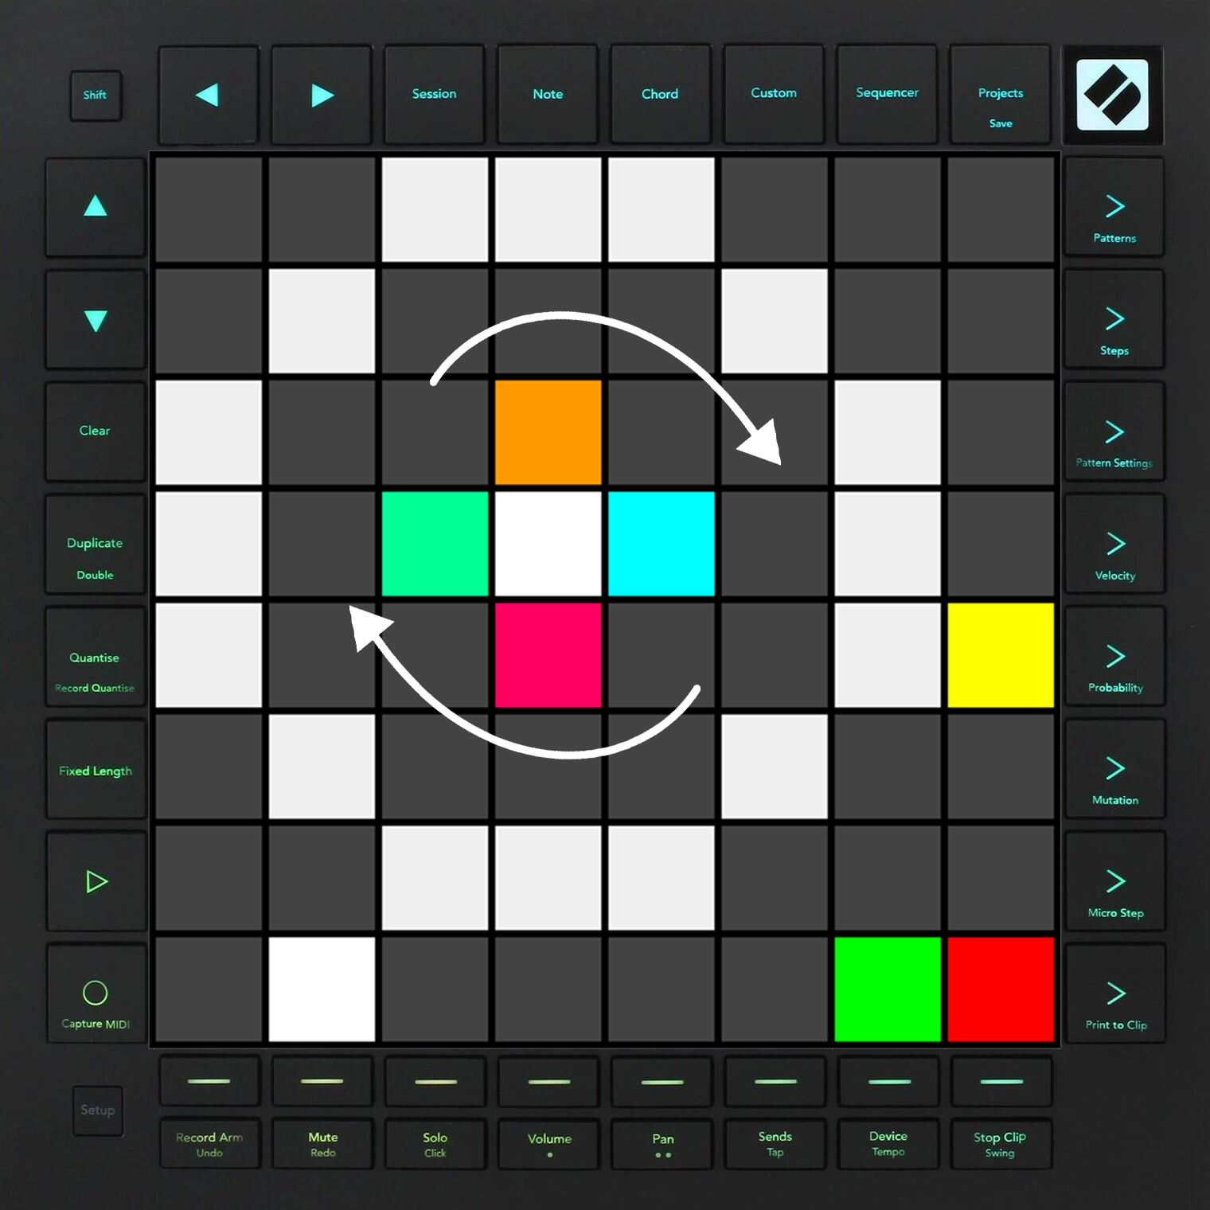
Hard Mode

Slide 13

Hard Mode
Front Button
Right Button
Left Button
Back Button
Submit Button
Easy Mode
Level starts
Hard Mode

